Slide 1
SLO’s
Principles of SRE

Slide 2
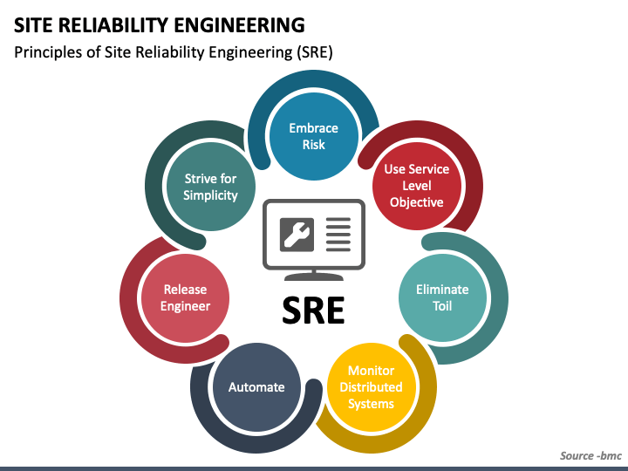

Slide 3
SLO’s
Define the lowest level of reliability that is acceptable for users of each service, then state that as your SLO.
Every service should have an availability SLO—without it, your team and your stakeholders can’t make principled judgments about whether your service needs to be made more reliable

Slide 4
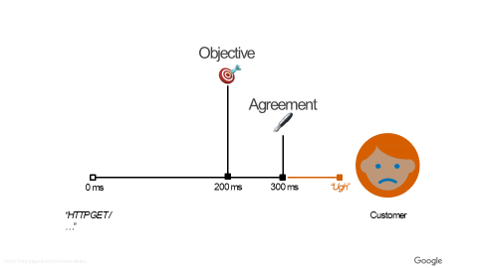

SLO
A principled way to agree on the desired reliability of a service

Slide 5

WHAT
SLOs allow you to quantifiably measure customer happiness, which directly impacts the business.
SLOs should capture the performance and availability levels that, if barely met, would keep the typical customer of a service happy
“meets SLO targets” ⇒ “happy customers”
“sad customers” ⇒ “misses SLO targets”

Slide 6


SLO
Measure SLO achieved & try to be slightly over target
SLI
Target

Slide 7
Error Budgets
An SLO implies an acceptable level of unreliability
This is a budget that can be allocated

Slide 8
Implementation Mechanics
Evaluate SLO performance over a set window, e.g. 28 days Remaining budget drives prioritization of engineering effort

Slide 9
Error budgets can accommodate
⁄ releasing new features
⁄ expected system changes
⁄ inevitable failure in hardware, networks, etc.
⁄ planned downtime
⁄ risky experiments

Slide 10
Why SREs Need SLOs
Read this source
https://www.dynatrace.com/news/blog/the-role-of-service-level-objectives-slos-in-sre/

Slide 11
How to design SLO
let’s assume that your service is some form of code that has been compiled and released and is running on networked infrastructure that users access via the web.
Your system’s maturity level might be one of the following:
A greenfield development, with nothing currently deployed
A system in production with some monitoring to notify you when things go wrong,
but no formal objectives, no concept of an error budget, and an unspoken goal of 100% uptime
A running deployment with an SLO below 100%,
but without a common understanding about its importance or how to leverage it to make continuous improvement choices—in other words, an SLO without teeth
Notes:
Greenfield development refers to the process of creating a new project, system, or infrastructure from scratch, typically in an area that has not been developed or built on before.

Slide 12
How to design SLO
In order to adopt an error budget-based approach to Site Reliability Engineering, you need to reach a state where the following hold true:
There are SLOs that all stakeholders in the organization have approved as being fit for the product.
The people responsible for ensuring that the service meets its SLO have agreed that it is possible to meet this SLO under normal circumstances.
The organization has committed to using the error budget for decision making and prioritizing. This commitment is formalized in an error budget policy.
There is a process in place for refining the SLO.

Slide 13
Reliability Targets and Error Budgets
An SLO sets a target level of reliability for the service’s customers. Above this threshold, almost all users should be happy with your service (assuming they are otherwise happy with the utility of the service).
Below this threshold, users are likely to start complaining or to stop using the service.
Problem :Customer happiness is a rather fuzzy concept; we can’t measure it precisely. Often we have very little visibility into it at all, so how do we begin? What do we use for our first SLO?

Slide 14
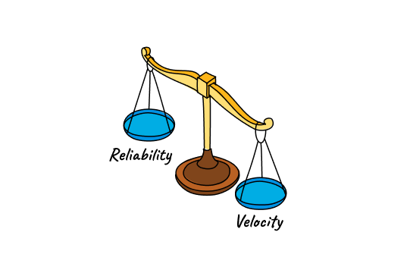
Cont..
Can we have 100% Reliability as target???
Once you have an SLO target below 100%, it needs to be owned by someone in the organization who is empowered to make tradeoffs between feature velocity and reliability.
In a small organization, this may be the CTO; in larger organizations, this is normally the product owner (or product manager).
Notes:
Feature velocity refers to the rate at which new features or functionalities are developed, implemented, and deployed within a software development process
Our experience has shown that 100% reliability is the wrong target:
If your SLO is aligned with customer satisfaction, 100% is not a reasonable goal. Even with redundant components, automated health checking, and fast failover, there is a nonzero probability that one or more components will fail simultaneously, resulting in less than 100% availability.
Even if you could achieve 100% reliability within your system, your customers would not experience 100% reliability. The chain of systems between you and your customers is often long and complex, and any of these components can fail.³ This also means that as you go from 99% to 99.9% to 99.99% reliability, each extra nine comes at an increased cost, but the marginal utility to your customers steadily approaches zero.
If you do manage to create an experience that is 100% reliable for your customers, and want to maintain that level of reliability, you can never update or improve your service. The number one source of outages is change: pushing new features, applying security patches, deploying new hardware, and scaling up to meet customer demand will impact that 100% target. Sooner or later, your service will stagnate and your customers will go elsewhere, which is not great for anyone’s bottom line.
An SLO of 100% means you only have time to be reactive. You literally cannot do anything other than react to < 100% availability, which is guaranteed to happen. Reliability of 100% is not an engineering culture SLO—it’s an operations team SLO.

Slide 15
Question
Once you agree that 100% is the wrong number, how do you determine the right number? And what are you measuring, anyway?
SLI’s is the answer

Slide 16
What to Measure: Using SLIs
Service Level Indicators come into play: an SLI is an indicator of the level of service that you are providing.

Slide 17

unhappy
users
time

Slide 18


GOOD
BAD
metric
metric
time
time

Slide 19
SLI’s
While many numbers can function as an SLI, generally recommended is treating the SLI as the ratio of two numbers:
the number of good events divided by the total number of events.
For example:
Number of successful HTTP requests / total HTTP requests (success rate)
Number of gRPC calls that completed successfully in < 100 ms / total gRPC requests
Number of search results that used the entire corpus / total number of search results, including those that degraded gracefully
Number of “stock check count” requests from product searches that used stock data fresher than 10 minutes / total number of stock check requests
Number of “good user minutes” according to some extended list of criteria for that metric / total number of user minutes
Notes:
gRPC Remote Procedure Call, is an open-source remote procedure call

Slide 20
good events valid events
SLI :
× 100%
3–5 SLIs*
* per user journey

Slide 21
SLI’s
The SLI ranges from 0% to 100%,
where 0% means nothing works, and 100% means nothing is broken.
We have found this scale intuitive, and this style lends itself easily to the concept of an error budget:
The SLO is a target percentage and the error budget is 100% minus the SLO.
For example, if you have a 99.9% success ratio SLO, then a service that receives 3 million requests over a four-week period had a budget of 3,000 (0.1%) errors over that period. If a single outage is responsible for 1,500 errors, that error costs 50% of the error budget.⁴

Slide 22
Tip
In addition, making all of your SLIs follow a consistent style allows you to take better advantage of tooling:
you can write alerting logic, SLO analysis tools, error budget calculation, and reports to expect the same inputs: numerator, denominator, and threshold. Simplification is a bonus here.
SLI ≤ target or lower bound ≤ SLI ≤ upper bound.

Slide 23
SLI division
When attempting to formulate SLIs for the first time, you might find it useful to further divide SLIs into SLI specification and SLI implementation:
SLI specification
The assessment of service outcome that you think matters to users, independent of how it is measured
An SLI specification is a formal statement of your users' expectations about one particular dimension of reliability for your service, like latency or availability.
For example: Ratio of home page requests that loaded in < 100 ms
SLI implementation
The SLI specification and a way to measure it.
Once SLIs has been specified for a system, the next step is to refine them into implementations by making decisions around measurement, validity and how to classify events as good
For example:
Ratio of home page requests that loaded in < 100 ms, as measured from the Latency column of the server log. This measurement will miss requests that fail to reach the backend

Slide 24
SLI Implementation
Ratio of home page requests that loaded in < 100 ms, as measured by probers that execute JavaScript in a browser running in a virtual machine. This measurement will catch errors when requests cannot reach our network, but may miss issues that affect only a subset of users.
Ratio of home page requests that loaded in < 100 ms, as measured by instrumentation in the JavaScript on the home page itself, and reported back to a dedicated telemetry recording service. This measurement will more accurately capture the user experience, although we now need to modify the code to capture this information and build the infrastructure to record it—a specification that has its own reliability requirements.

Slide 25
SLI’s
To create your first set of SLOs, you need to decide upon a few key SLI specifications that matter to your service.
Availability and latency SLOs are pretty common; freshness, durability, correctness, quality, and coverage SLOs also have their place

Slide 26
Guidelines
If you are having trouble figuring out what sort of SLIs to start with, it helps to start simple:
Choose one application for which you want to define SLOs. If your product comprises many applications, you can add those later.
Decide clearly who the “users” are in this situation. These are the people whose happiness you are optimizing.
Consider the common ways your users interact with your system—common tasks and critical activities.
Draw a high-level architecture diagram of your system; show the key components, the request flow, the data flow, and the critical dependencies. Group these components into categories listed in the following section (there may be some overlap and ambiguity; use your intuition and don’t let perfect be the enemy of the good).

Slide 27
How to implement the principle of service level objectives
Build SLIs by looking at how customers use your services. Craft user journeys and consider what services are most essential at each step.
Set your SLO at the customer’s pain point. For each SLI, determine where the customer would experience pain from unreliability.
Ensure that your SLOs are monitor able. Get access to all the data you need to keep the SLO up-to-date. Make sure that anything that could affect the SLI is being represented.
Set policies for your error budget. When the error budget runs low, figure out what you’ll do to prevent an SLO breach. When you have budget left, figure out how you’ll increase development efforts.
Review and revise your SLIs and SLOs. As your service changes and grows, what’s important to customers will change too. Set a schedule to review your SLOs and make sure they’re still reflecting customer happiness.

Slide 28
Types of components
The easiest way to get started with setting SLIs is to abstract your system into a few common types of components. You can then use our list of suggested SLIs for each component to choose the ones most relevant to your service:
Request-driven
The user creates some type of event and expects a response. For example, this could be an HTTP service where the user interacts with a browser or an API for a mobile application.
Pipeline
A system that takes records as input, mutates them, and places the output somewhere else. This might be a simple process that runs on a single instance in real time, or a multistage batch process that takes many hours. Examples include:
A system that periodically reads data from a relational database and writes it into a distributed hash table for optimized serving
A video processing service that converts video from one format to another
A system that reads in log files from many sources to generate reports
A monitoring system that pulls metrics from remote servers and generates time series and alerts
Storage
A system that accepts data (e.g., bytes, records, files, videos) and makes it available to be retrieved at a later date.

Slide 29
Type of service | Type of SLI | Description
Request-driven | Availability | The proportion of requests that resulted in a successful response.
Request-driven | Latency | The proportion of requests that were faster than some threshold.
Pipeline | Correctness | The proportion of records coming into the pipeline that resulted in the correct value coming out.
Storage | Durability | The proportion of records written that can be successfully read. Take particular care with durability SLIs: the data that the user wants may be only a small portion of the data that is stored. For example, if you have 1 billion records for the previous 10 years, but the user wants only the records from today (which are unavailable), then they will be unhappy even though almost all of their data is readable.

Slide 30
API and HTTP server availability and latency
The response success on the HTTP status code. 5XX responses count against SLO, while all other requests are considered successful.
Availability SLI is the proportion of successful requests, and our latency SLIs are the proportion of requests that are faster than defined thresholds.
SLIs can use one or more of the following sources:
Application server logs
Load balancer monitoring
Black-box monitoring
Client-side instrumentation

Slide 31
Developing SLOs and SLIs

Slide 32

Our Game: Fang Faction
Leaderboards
Web Server
Leaderboard Generation
User Proﬁles
Load Balancer
Game Servers
API Server
Notes:
art-of-slos-handbook-a4.pdf

Slide 33

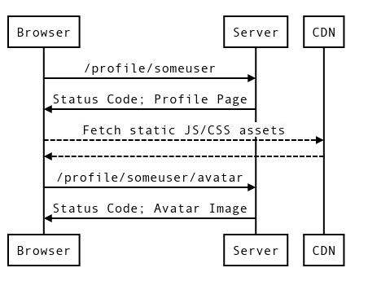
SomeUser's Profile
https://fangfactiongame.com/proﬁle/someuser
Faction Name:
Leader Name: Email Address:
Tribe of Frog
SomeUser
SomeUser Tribe of Frog
Faction Score: 31337
Midwest Canyon
user@example.com
Tri-Bool
Tri Repetae
65535
61995
Update
Triassic Five 52391
Tricksy Hobbits 37164
Tribe of Frog 31337
Trite Examples 29243

Slide 34
Loading a Profile Page
Leaderboards
Web Server
Leaderboard Generation
User Proﬁles
Load Balancer
Game Servers
API Server

Slide 35
SLI Menu
Request / Response
Availability Latency Quality
Data Processing
Coverage Correctness Freshness Throughput
Storage
Throughput Latency

Slide 36
Latency
Availability
The proﬁle page should load successfully
The proﬁle page should load quickly

Slide 37
Latency
Availability
The proﬁle page should load successfully
The proﬁle page should load quickly
How do we deﬁne quickly?
When does the timer start / stop?
How do we deﬁne success?
Where is the success / failure recorded?

Slide 38
Latency
Availability
The proﬁle page should load successfully
The proﬁle page should load quickly
How do we deﬁne quickly?
When does the timer start / stop?
The proportion of valid requests served faster than a threshold.
How do we deﬁne success?
Where is the success / failure recorded?
The proportion of valid requests served successfully.

Slide 39
Latency
Availability
The proﬁle page should load successfully
The proﬁle page should load quickly
How do we deﬁne quickly?
When does the timer start / stop?
The proportion of valid requests served faster than a threshold.
How do we deﬁne success?
Where is the success / failure recorded?
The proportion of valid requests served successfully.

Slide 40
Latency
Availability
The proﬁle page should load successfully
The proﬁle page should load quickly
How do we deﬁne quickly?
When does the timer start / stop?
The proportion of HTTP GET requests for /proﬁle/{user}
served faster than a threshold.
How do we deﬁne success?
Where is the success / failure recorded?
The proportion of HTTP GET requests
for /proﬁle/{user} or /proﬁle/{user}/avatar
served successfully.

Slide 41
Latency
Availability
The proﬁle page should load successfully
The proﬁle page should load quickly
How do we deﬁne quickly?
When does the timer start / stop?
The proportion of HTTP GET requests for /proﬁle/{user}
served faster than a threshold.
How do we deﬁne success?
Where is the success / failure recorded?
The proportion of HTTP GET requests
for /proﬁle/{user} or /proﬁle/{user}/avatar
served successfully.

Slide 42
Latency
Availability
The proﬁle page should load successfully
The proﬁle page should load quickly
How do we deﬁne quickly?
When does the timer start / stop?
The proportion of HTTP GET requests for /proﬁle/{user}
served within X ms.
How do we deﬁne success?
Where is the success / failure recorded?
The proportion of HTTP GET requests
for /proﬁle/{user} or /proﬁle/{user}/avatar
that have 2XX, 3XX or 4XX (excl. 429) status.

Slide 43
SLI Menu
Application-level Metrics Logs Processing
Front-end Infra Metrics Synthetic Clients/Data Client-side Instrumentation
Measurement Strategies

Slide 44
Latency
Availability
The proﬁle page should load successfully
The proﬁle page should load quickly
How do we deﬁne quickly?
When does the timer start / stop?
The proportion of HTTP GET requests for /proﬁle/{user}
that send their entire response within X ms
measured at the load balancer.
How do we deﬁne success?
Where is the success / failure recorded?
The proportion of HTTP GET requests
for /proﬁle/{user} or /proﬁle/{user}/avatar that have 2XX, 3XX or 4XX (excl. 429) status measured at the load balancer.

Slide 45
Activity
Postmortem

Slide 46
Latency
Availability
Proportion of HTTP GET requests
for /proﬁle/{user} or /proﬁle/{user}/avatar that have 2XX, 3XX or 4XX (excl. 429) status measured at the load balancer
and
Proportion of HTTP GET requests
for /proﬁle/prober_user and all linked resources returning valid HTML containing "ProberUser" measured by a black-box prober every 5s
Proportion of HTTP GET requests for /proﬁle/{user}
that send their entire response within X ms
measured at the load balancer

Slide 47

Do the SLIs cover the failure modes?
Availability
Availability Latency
Black Box Prober
Load Balancer
Leader Boards
Web Server
Leaderboard Generation
User Proﬁles
Game Servers
API Server

Slide 48
Activity
Deﬁne SLO Targets

Slide 49
What goals should we set for the reliability of our journey?
Your objectives should have both a target and a measurement window
Service | SLO Type | Objective
Web: User Proﬁle | Availability | 99.95% successful in previous 28d
Web: User Proﬁle | Latency | 90% of requests < 500ms in previous 28d
... | ...
Notes:
We're going to call a set of interactions to achieve a single goal a user journey一a term we've borrowed from the field of user experience research

Slide 50
Break!

Slide 51
Workshop: Let's develop some more SLIs and SLOs!
Follow the process we demonstrated for the Buy In-Game Currency journey:
Choose SLI speciﬁcations from the menu
Substitute deﬁnitions in to create a detailed SLI implementation
Walk through user journey and look for coverage gaps
Set aspirational SLOs based on business needs
Once you're done, choose another journey as a group.
You have roughly 45 minutes for each journey.

Slide 52

Our Game: Fang Faction
Leaderboards
Web Server
Leaderboard Generation
User Proﬁles
Load Balancer
Game Servers
API Server
Play Store

Slide 53
Break!

Slide 54
Buy In-Game Currency
Model Answer

Slide 55
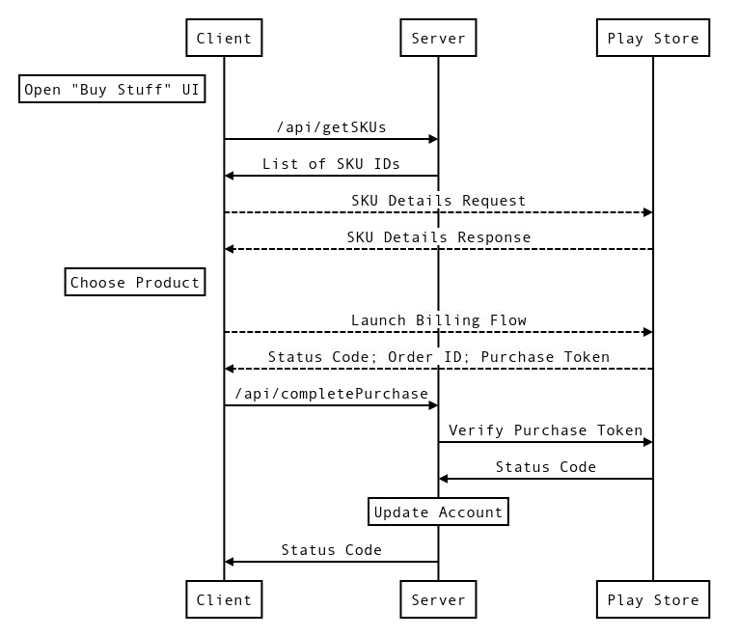
Break Down The Journey
1
2
Five request/response pairs
Fetch list of SKUs from API server
Fetch SKU details from Play Store
User launches Play billing ﬂow
Send token to API server
Verify token with Play Store
3
4
5

Slide 56
Break Down The Journey
1
2
Journey has two parts. A: Fetch SKUs
Fetch list of SKUs from API server
Fetch SKU details from Play Store
User launches Play billing ﬂow
Send token to API server
Verify token with Play Store

Slide 57
Break Down The Journey
Journey has two parts. B: Buy Item
Fetch list of SKUs from API server
Fetch SKU details from Play Store
User launches Play billing ﬂow
Send token to API server
Verify token with Play Store
3
4
5

Slide 58
Break Down The Journey
1
2
User might choose not to buy an item :-(
Fetch list of SKUs from API server
Fetch SKU details from Play Store
User launches Play billing ﬂow
Send token to API server
Verify token with Play Store
We have to treat these parts separately!

Slide 59
Break Down The Journey
Two requests don't hit API server at all!
Fetch list of SKUs from API server
Fetch SKU details from Play Store
User launches Play billing ﬂow
Send token to API server
Verify token with Play Store
2
3
Server or load balancer metrics may not give enough coverage of the journey :-(

Slide 60
Break Down The Journey
Two requests don't hit API server at all!
Fetch list of SKUs from API server
Fetch SKU details from Play Store
User launches Play billing ﬂow
Send token to API server
Verify token with Play Store
2
3
Server or load balancer metrics may not give enough coverage of the journey :-(
… we'll have to ask our users to consent
to client-side telemetry.

Slide 61
Buy Flow What SLIs?
Buy Flow journey is
Request / Response
SLI menu suggests we use
Availability and Latency SLIs

Slide 62
Buy Flow Availability: Speciﬁcation
B makes money, so let's start with that
Fetch list of SKUs from API server
Fetch SKU details from Play Store
User launches Play billing ﬂow
Send token to API server
Verify token with Play Store
3
4
Availability SLI Speciﬁcation
The proportion of valid requests served successfully.
5

Slide 63
Buy Flow Availability: Valid Requests
Availability SLI
The proportion of valid requests served successfully.
… but which requests are valid?
User launches Play billing ﬂow
Send token to API server?
Verify token with Play Store?
3
Launching the billing ﬂow indicates a user's intent to buy a product
Users consenting to client-side telemetry collection allows us to track this intent

Slide 64
Buy Flow Availability: Success Criteria
Availability SLI
The proportion of launched billing ﬂows from users consenting to collection served successfully.
… and how do we determine success?
3
4
All interactions must be successful!
Good status code; purchase token
Good status code; account updated
Good status code; valid token
Return 402 to API call when token is invalid
5

Slide 65
Buy Flow Availability: Measurement
Availability SLI
The proportion of launched billing ﬂows from users consenting to collection where the billing ﬂow returns:
OK and a purchase token
or FEATURE_NOT_SUPPORTED
or ITEM_UNAVAILABLE
or USER_CANCELED
3
4
and /api/completePurchase returns:
200 OK and Parseable JSON
or 402 Payment Required
… but where are we measuring this?

Slide 66
Buy Flow Availability: Measurement
Availability SLI
The proportion of launched billing ﬂows from users consenting to collection where the billing ﬂow returns:
OK
or FEATURE_NOT_SUPPORTED
or ITEM_UNAVAILABLE
or USER_CANCELED
3
4
and /api/completePurchase returns:
200 OK
or 402 Payment Required
and Parseable JSON
measured by the game client and reported back asynchronously.

Slide 67
Buy Flow Latency: Speciﬁcation
We want to measure latency for B too!
Fetch list of SKUs from API server
Fetch SKU details from Play Store
User launches Play billing ﬂow
Send token to API server
Verify token with Play Store
3
4
Latency SLI Speciﬁcation
The proportion of valid requests served faster than a threshold.
5

Slide 68
Buy Flow Latency: Valid Requests
Latency SLI
The proportion of valid requests served faster than a threshold.
… but which requests are valid?
User launches Play billing ﬂow?
Send token to API server
Verify token with Play Store?
4
Why not 3?
Too variable, SLI will have poor SnR
Billing ﬂow contains lots of "poking device with a ﬁnger" time

Slide 69
Buy Flow Latency: "Too Slow" Threshold
Latency SLI
The proportion
of /api/completePurchase requests
served faster than a threshold.
… and what is fast enough? Rough estimate time!
Verify Token <= 500ms
Database Write <= 200ms
Round up a bit…

Slide 70
Buy Flow Latency: Measurement
Latency SLI
The proportion
of /api/completePurchase requests
served within 1000ms.
… but where are we measuring this? Where does the timer start/stop?

Slide 71
Buy Flow Latency: Measurement
Latency SLI
The proportion
of /api/completePurchase requests where the complete response is returned to the client within 1000ms measured at the load balancer.

Slide 72
A brief word from our sponsors...

Slide 73
https://cre.page.link/art-of-slos

Slide 74
https://sre.google/workbook/implementing-slos/
https://docs.google.com/document/d/1bRkVu7tuow3K21669mzXEEhk1Ki-iukMFehZAR0dAvU/edit
https://cloud.google.com/blog/products/devops-sre/sre-fundamentals-sli-vs-slo-vs-sla
https://cloud.google.com/blog/products/management-tools/practical-guide-to-setting-slos
https://cloud.google.com/blog/products/devops-sre/how-sres-analyze-risks-to-evaluate-slos

Slide 75
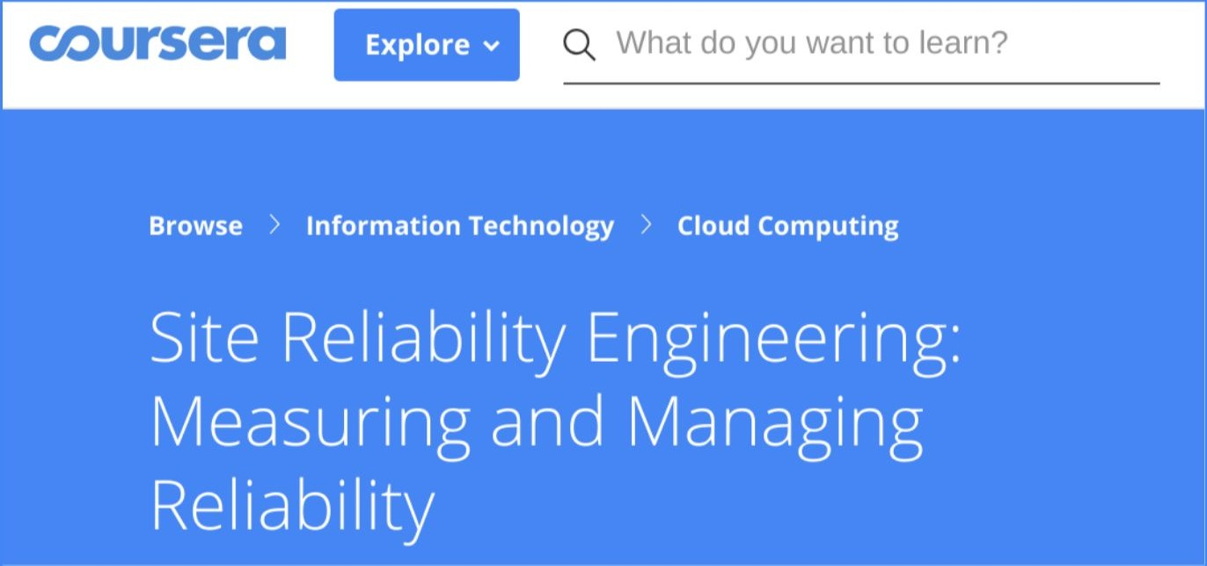
Want to learn more about SLOs? Take our course on Coursera: https://cre.page.link/coursera

Slide 76
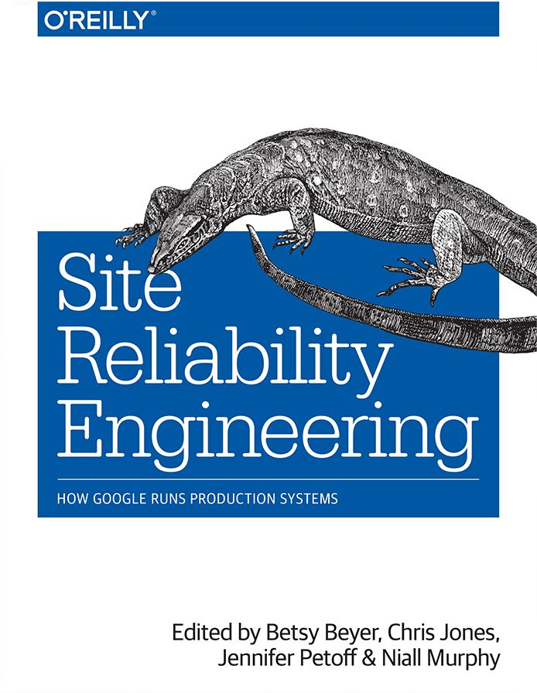
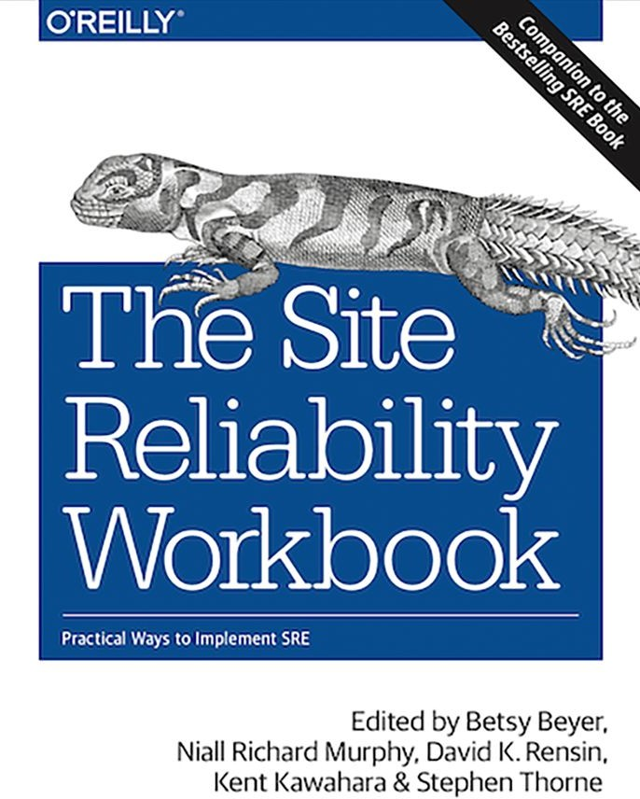
Both of these are now available in HTML format for free! https://landing.google.com/sre/books/

Slide 77
Q&A

